Slide 1
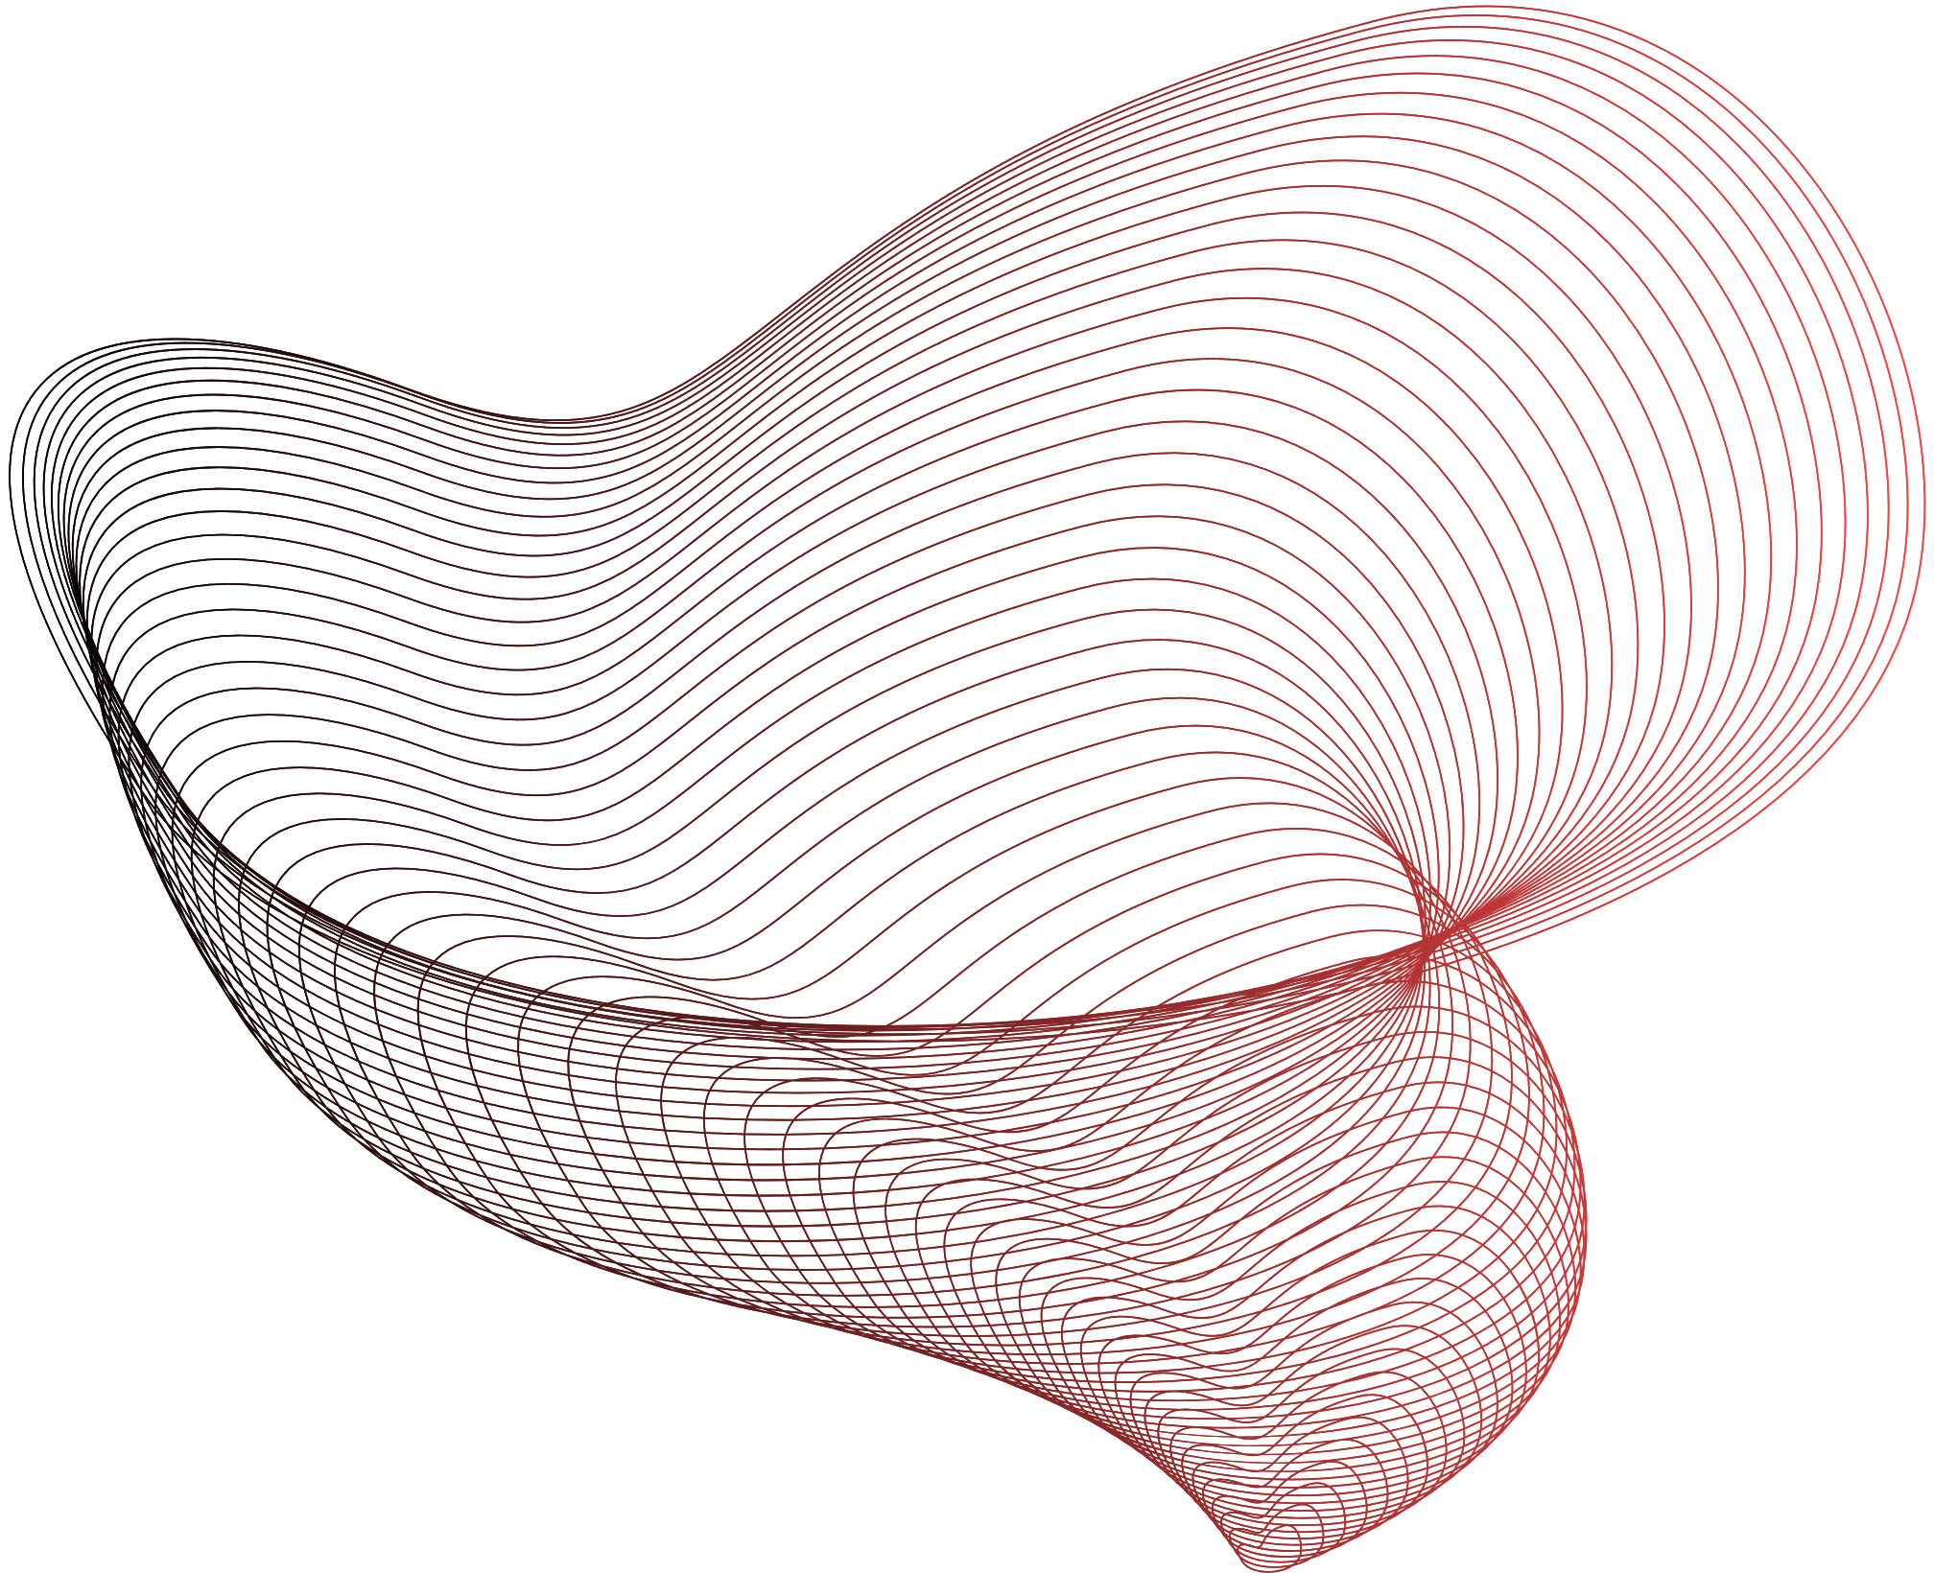

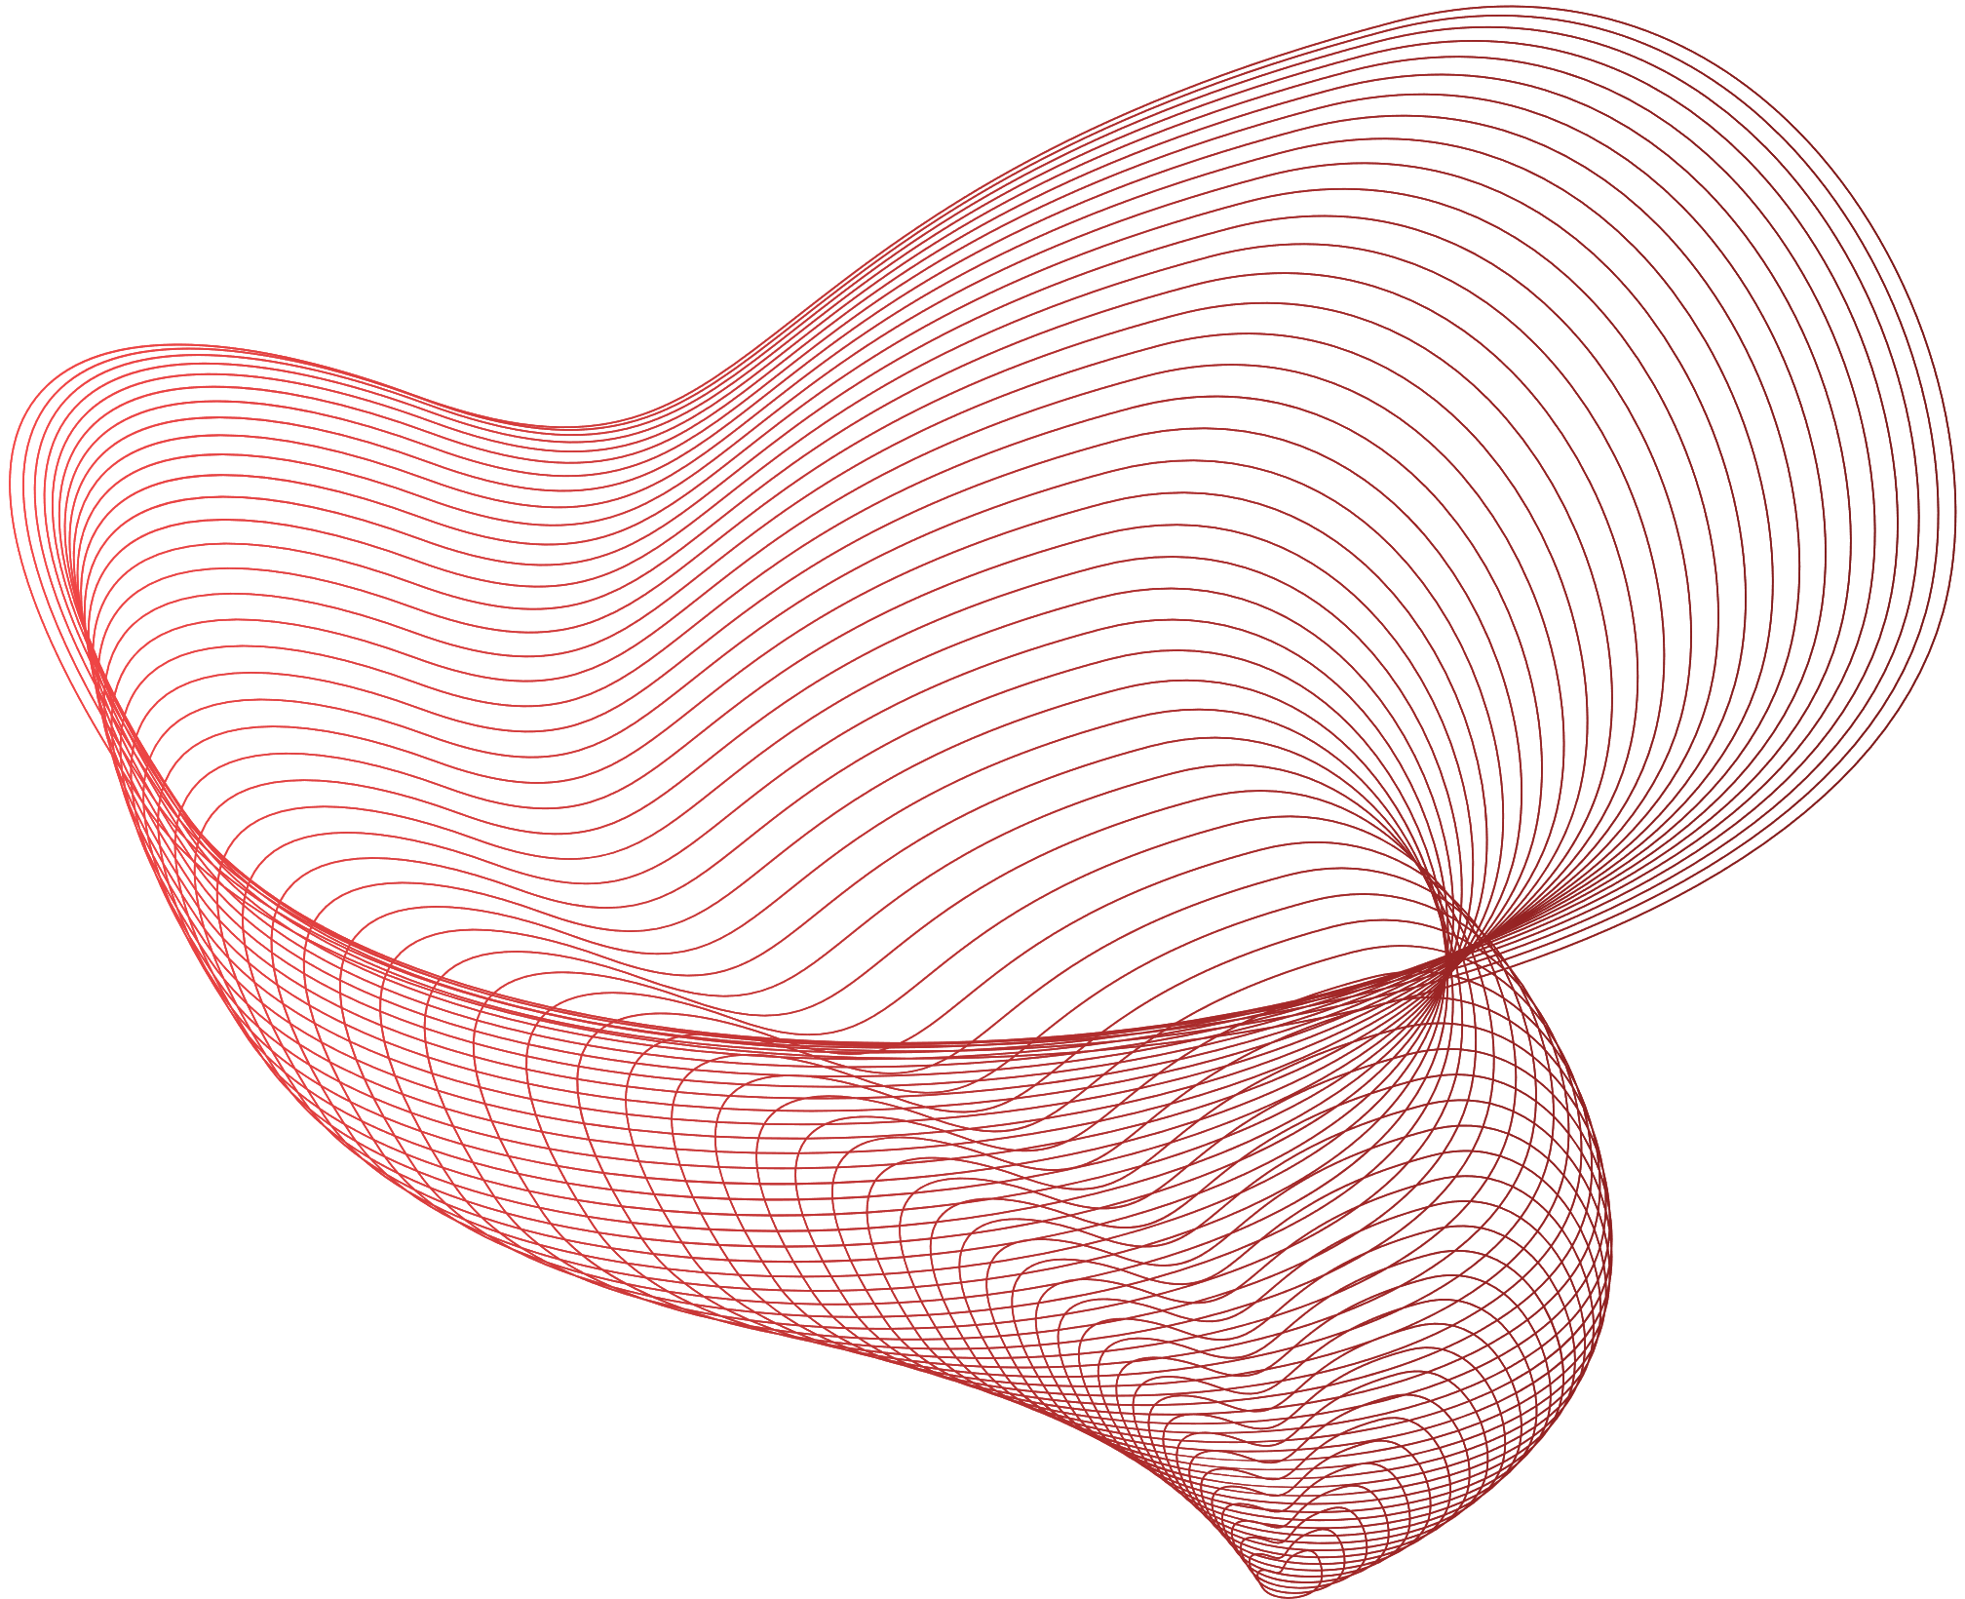
PLANT LEAF DISEASE DETECTION
B-GROUP-7

Slide 2

Agenda
TEAM MEMBERS
INTRODUCTION
OBJECTIVE
LITERATURE REVIEW
METHODOLOGY
IMPLEMENTATION
RESULT AND ANALYSIS
DISCUSSION
TIME LINE
FUTURE WORKS
CONCLUSION

Slide 3
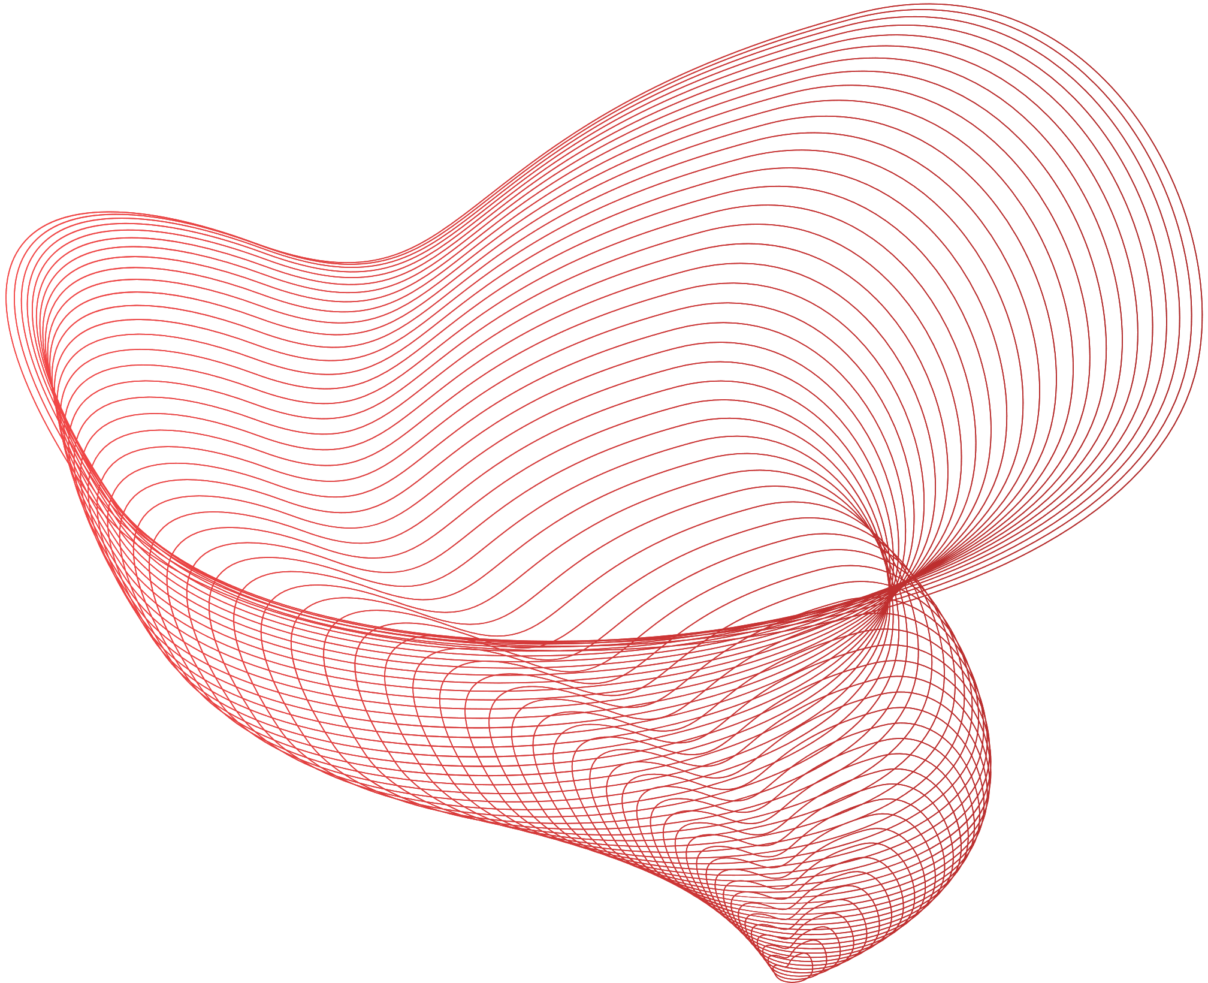
TEAM MEMBERS
LAKSHMI | CB..SC.U4AIE24116
SRINIVAS | CB.SC.U4AIE24140
MYAGI | CB.SC.U4AIE24143
SRI SHANMATHI | CB.SC.U4AIE24152

Slide 4

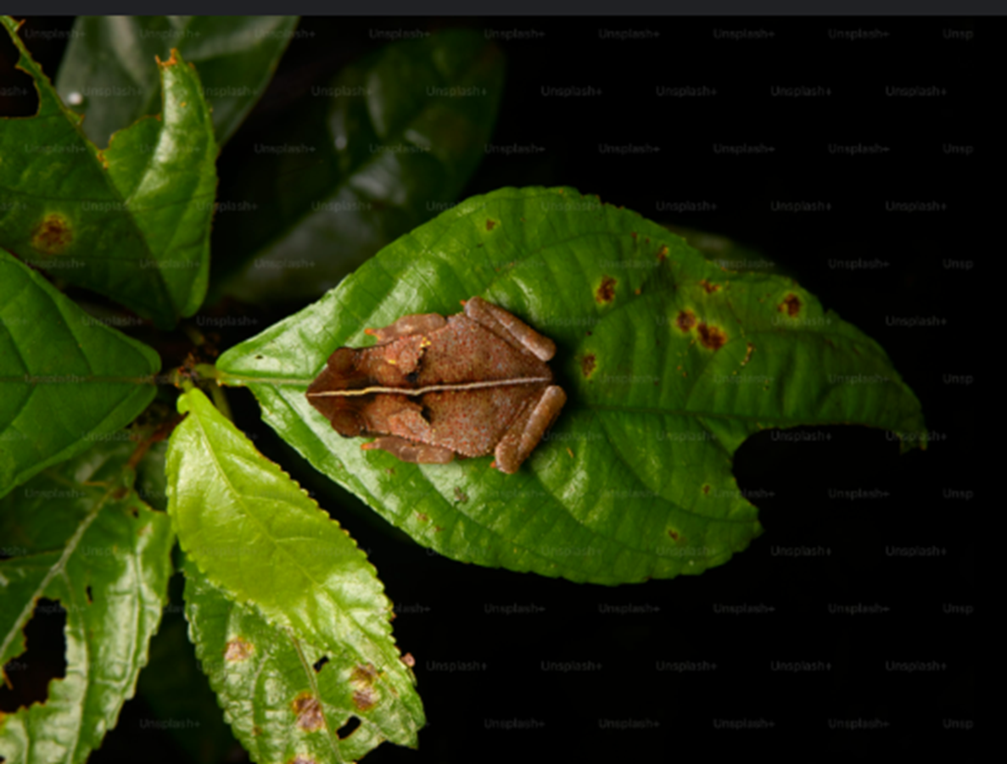
INTRODUCTION
This project aims to automate plant disease detection using image classification powered by Convolutional Neural Networks (CNN).
It enables quick, accurate identification of plant diseases from leaf images, reducing dependency on manual inspection and supporting precision agriculture

Slide 5
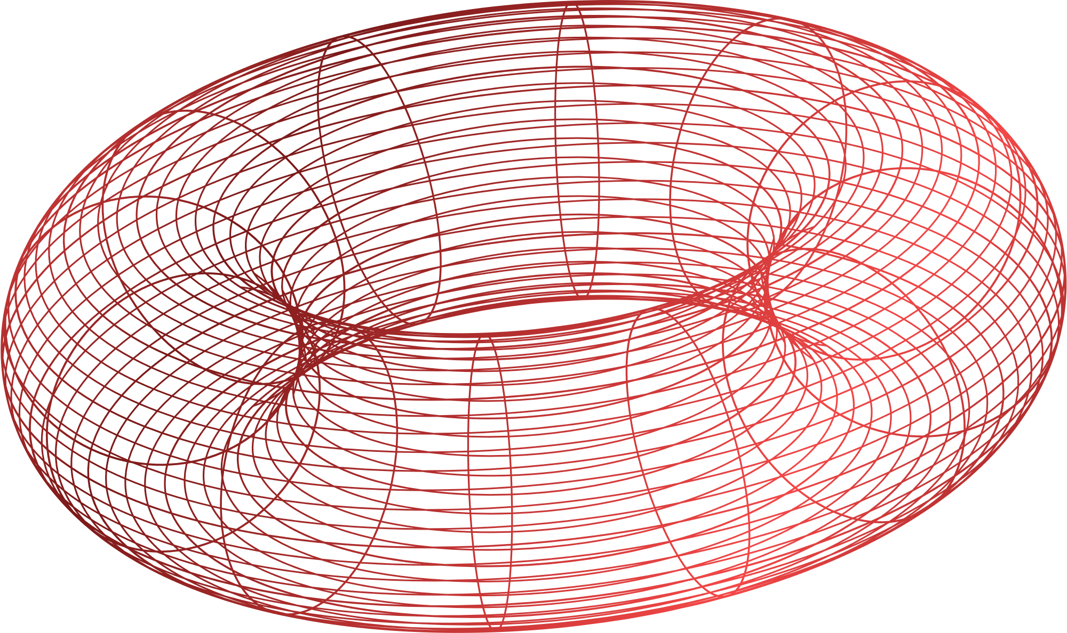
OBJECTIVE
MISSION | •To develop a high-accuracy deep learning model using CNN for real-time detection of leaf images and integrate it into an interactive Stream lit web application for user-friendly accessibility

Slide 6
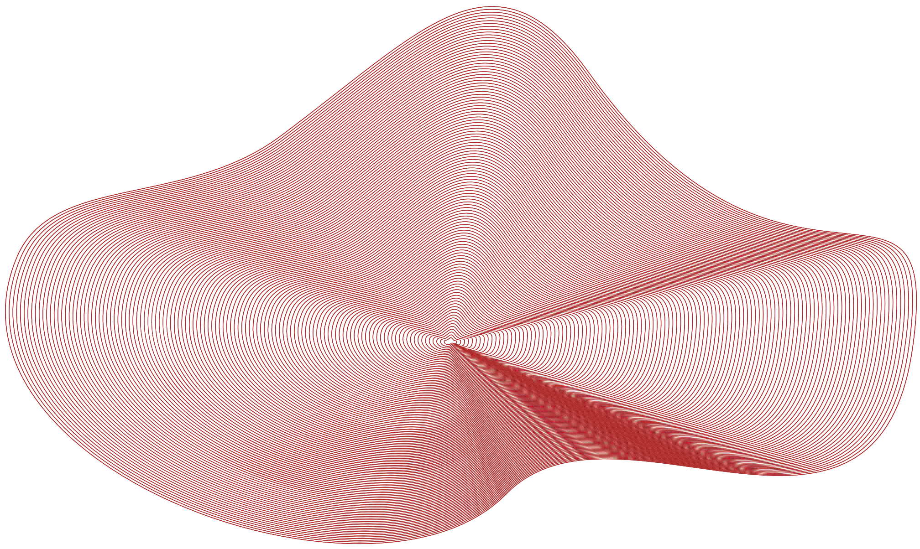
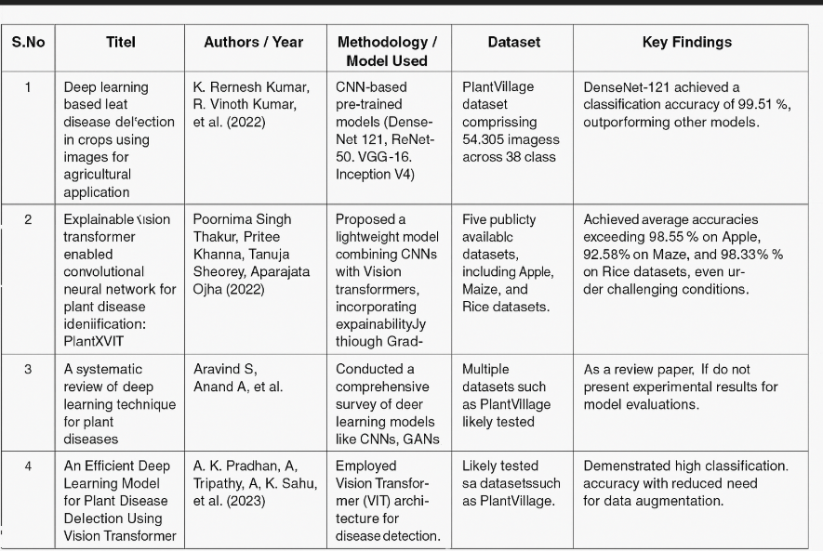
LITERATURE REVIEW

Slide 7

METHODOLOGY
The project uses the PlantVillage dataset, containing color images of healthy and diseased leaves across multiple plant categories.
The dataset was downloaded using the Kaggle API and extracted locally for model development.
All images were resized to 128×128 pixels to maintain consistent input dimensions for the model.
ImageDataGenerator was used for image preprocessing, performing: Normalization by rescaling pixel values to the range [0, 1]. Splitting the dataset into 80% for training and 20% for validation.
The CNN model was built using the TensorFlow Keras Sequential API for structured and flexible model design.

Slide 8
It consists of five convolutional blocks designed to extract image features at multiple levels.
A Conv2D layer with He Normal initialization for stable weight distribution. Batch Normalization to speed up and stabilize the training process.
The ELU activation function, which efficiently handles both positive and negative values. SpatialDropout2D with a dropout rate of 0.2 to prevent overfitting.
MaxPooling2D with padding to reduce the spatial size of the feature maps.
The number of filters progressively increases like 32 → 64 → 128 → 256 → 512.

Slide 9
A GlobalAveragePooling2D layer was used after the convolutional blocks to reduce dimensionality and overfitting.
Each Dense layer is followed by: Batch Normalization for training stability.
ELU activation functions for better learning. Dropout with a rate of 0.4 to improve generalization.
The output layer uses a Softmax activation function to predict probabilities for multiple disease classes.The output layer uses a Softmax activation function to predict probabilities for multiple disease classes.
The model was compiled with categorical crossentropy loss with label smoothing (0.1) to handle multi-class predictions.

Slide 10
Adam optimizer with an ExponentialDecay learning rate schedule was used for adaptive, efficient training
The model was trained for up to 40 epochs, with early stopping enabled to avoid overfitting
Training was monitored by tracking accuracy and loss for both training and validation sets during each epoch.
A confusion matrix was generated to compare actual disease categories against the model’s predictions.
Final Model Performance: Validation Accuracy: 98.34% Loss: 0.8694

Slide 11
Prediction functions were created to load, preprocess, and classify single images using the trained model.
An interactive Streamlit app was built using PyCharm to offer a simple, web-based interface for disease prediction.
Users can upload plant leaf images directly into the app interface for classification.
The app displays real-time predictions along with confidence percentages after processing each image.
The system was designed for easy, practical deployment, offering farmers and researchers a quick and reliable disease detection tool.

Slide 12
Tools & Platforms:
- Google Colab (T4 GPU) – For model training
- PyCharm – For Streamlit app deployment
- Kaggle API– To download the dataset
Main Libraries:
- TensorFlow & Keras– For building and training the model
- Matplotlib – For visualizing results
- Streamlit – For creating the web app
Steps:
1. Downloaded the PlantVillage dataset from Kaggle
2. Preprocessed images and split data for training and validation
3. Built a CNN model for classification
4. Trained the model and evaluated performance
5. Deployed the model in a Streamlit app for predictions
IMPLEMENTATION

Slide 13
DISCUSSION
The integration of Streamlit significantly enhances usability, making AI-powered plant disease detection approachable for farmers and agricultural professionals. While the CNN model’s accuracy is high for known classes, it’s still limited to predicting diseases it was trained on. The system offers fast, real-time predictions but could be affected by poor image quality or unknown disease cases.

Slide 14

WEEK 1
Collecting the research papers and understanding CNN.
WEEK 2
Searching Dataset and preprocessing it.
WEEK 3
Working on the codes
WEEK 4
TIME LINE
Develop a Stream lit Web

Slide 15
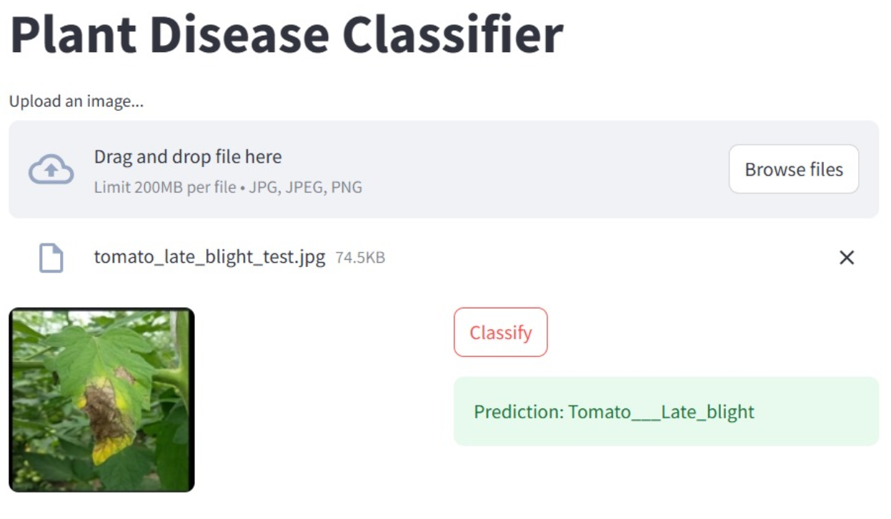
RESULT &
ANALYSIS
Final Model Performance:
Validation Accuracy: 98.34%
Loss: 0.8694
Model Evaluation:
Achieved high accuracy and low loss during training and validation

Slide 16
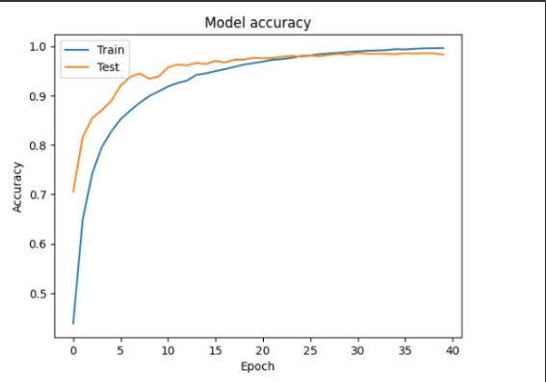
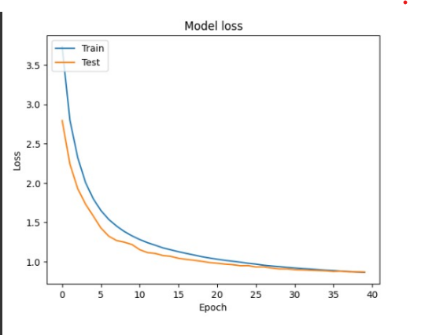

Slide 17
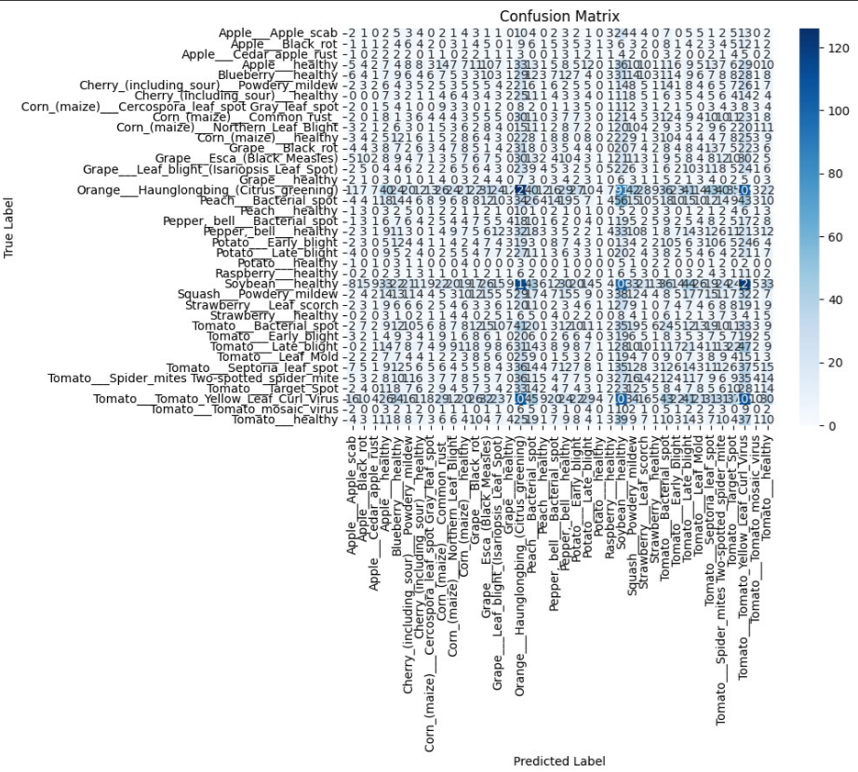
This confusion matrix shows the classification results of our CNN model for various plant diseases. High values on the diagonal, such as Tomato___Leaf_Mold (47) and Tomato___Target_Spot (42), indicate strong prediction accuracy for those classes. Some misclassifications are visible off-diagonal — for example, a few Tomato___Early_blight images were confused with Tomato___Late_blight. These insights help in identifying where the model needs improvement and which classes are most easily confused.

Slide 18
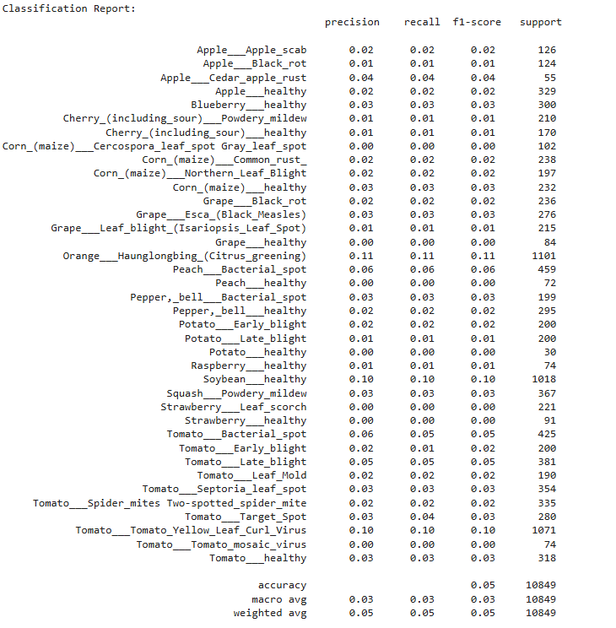
Classification report

Slide 19




Collect and include more types of plant leaf images to improve the system’s coverage.
FUTURE WORKS
Improve low-accuracy classes: Classes such as Grape___Esca, Orange___Huanglongbing, and Tomato___Leaf_Mold exhibit high misclassification rates. Future work should focus on improving their detection through targeted data augmentation and enhanced feature extraction techniques.
Display basic details about the predicted disease like symptoms and possible treatments right after classification

Slide 20
CONCLUSION
This project successfully combines deep learning with an interactive web interface to build an automated, accurate, and easy-to-use plant disease detection system. The CNN model, paired with Streamlit, offers instant predictions, supporting smarter agricultural practices and reducing diagnostic delays.

Slide 21

THANK YOU

